Slide 1
Gulf of Mexico Discoveries
Lower Tertiary Wells
8 November 2017

Slide 2
Agenda
Overview
Geological Time Scale (Erathem)
Lower tertiary(Paleogene)
Reservoirs
Identification of Wells
Blocks
Operators
Fields and operating companies
Contingent resources
Developed and producing resources
Resource Evaluation by Clients and Blocks
Dominant fields and Resource Evaluation
Boundary Identification
Lower Tertiary Wells by GIS Technologies
Reserves

Slide 3
Geology: Overview
Gulf of Mexico Basin Geology:
It is the basin that formed during the Late Triassic to Early Jurassic with the breakup of the Pangaean supercontinent when Africa and South America separated from North America
During the Middle Jurassic, Marine waters enters into GOM Basin ,that results in deposition of thick evaporate deposits of Louann salt.
During the Late Jurassic, a wide spread marine transgression deposited an organic rich carbonate mudstone became a major hydrocarbon source rock for the GOM.

Slide 4
Geological Time Scale (Erathem) :
Cenozoic Era:(65.5 million years ago to present)
Periods: Paleogene (65.5 to 23.03 million years ago), Neogene (23.03 to 2.6 million years ago) and the Quaternary (2.6 million years ago to present)
Early In this Era uplift of the North America and the subsequent Laramide Orogeny in the Late Cretaceous provides source for large amounts of siliciclastic sand and mud that were transported to the Texas and Louisiana coasts by the Mississippi River and other ancient river system.
Late in the Cenozoic, continental glaciation provides an increased clastic sediment load to the basin results in the modern Texas and Louisiana shelf and slope characterized by large amounts of clastic materials.
This loading and subsequent deformation of the Louann salt throughout time creates many regional structures that favourable for entrapment of hydrocarbons

Slide 5
continue
Mesozoic Era:(252.2 million years ago)
Periods: Triassic (251-199.6 million years ago), the Jurassic (199.6-145.5 million years ago), and the Cretaceous (145.5-65.5 million years ago).
Formed during middle Triassic to middle Jurassic period.
During the Late Jurassic , a widespread marine transgression deposited an organic rich carbonate becomes major source rock of GOM.
During the cretaceous period, thick reef complexes developed along the shelf edge.
This era mainly targets to date have been upper Jurassic siliciclastic Norphelt dunes and lower cretaceous James in the shallow OCS waters

Slide 6
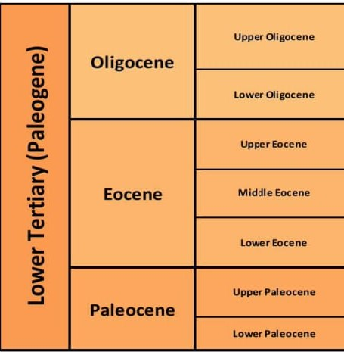
Lower tertiary(Paleogene)

Slide 7
continue
Lower tertiary informally (Paleogene)
This geologic trend in the Deepwater GOM has emerged as one of the world’s leading exploration plays due to significant, recent discoveries from Alaminos Canyon to Walker Ridge.
It plays vital role in onshore and Deepwater discoveries in GOM
The first well that penetrate Wilcox equivalent, Lower tertiary rocks GOM occurred in 1996 in Alaminos Canyon.
World’s water depth record spar installed in 2009 in Alaminos canyon block 857.
First production at the facility occurred in the year 2010.
First floating production storage offloading(FPSO) occurred in 2011

Slide 8
Reservoirs and properties
Lower Tertiary trend in ultra deep water areas is complicated by a salt-canopy system which overlies targeted sediments.
Normally these reservoirs in ultra Deepwater GOM are typically 2000o psi and 30000 psi ft. deep.
These reservoirs referred as tight with decreasing porosity and permeability. The average porosities are much lower than more prolific Miocene and younger producers in deep water.
Lower tertiary sands having reservoir permeability is about 25 millidarcys.

Slide 9
Identification
Wells identification:
By areas
By block numbers
And by latitude and longitude
Areas:
Most of the lower tertiary discoveries has seen in
Alaminos Canyon(Great White ,Tobago, Tiger, Trident and BAHA) .
Walker ridge(Cascade, Chinook, jack, St.Malo, Das Bump, Tucker, Julia, Hal, Logan, Coronado and Shenandoah)
Garden Banks(North Platte)
Keathley Canyon
Sigsbee Escarpment
Port Isabel
Green Canyon

Slide 10
Blocks
Block Numbers:
Walker Ridge (WR) [206,469,678,759,724,508,544,627,848,969,051,249,250,
425,098]
Alaminos Canyon (AC) [600,903,857,818,859,739,812,813,900,901]
Garden Banks(GB)[959]
Green Canyon(GC)[807]
Sigsbee Escarpment(SE)[39]
Port Isabel (PI)[525]
Keathley Canyon (KC)[785,736,292,872,102]

Slide 11
Operators
Shells own most number of wells in lower tertiary of (GOM).
Company Name | Wells Owned
Shell Offshore Inc. | 65
BP Exploration & Production Inc. | 15
Chevron U.S.A. Inc. | 22
Cobalt international energy | 10
Petrobras America Inc. | 21
Anadarko Petroleum co-operation | 12
Stat oil | 3
Exxon Mobil | 1
Devon energy | 1
Union oil company of California | 17
Freeport-McMoRan oil & gas | 2

Slide 12



















Fields and operating companies
Walker Ridge(WR)
Alaminos Canyon (AC)
Port Isabel (PI)
Garden Banks(GB)
Green Canyon(GC)
Keathley Canyon (KC)
Sigsbee Escarpment(SE)

Slide 13
Contingent resources
Blocks that are in the stage of development and producing In lower tertiary trend.
Contingent resources: These are defined as the resources estimated at a certain date as potentially recoverable from known accumulations, but which are not currently considered commercially recoverable.
Field | Block numbers
Walker Ridge(WR) | 848,544,051,098,969,724,
Alaminos Canyon (AC) | 818,903,600
Port Isabel (PI) | 525
Keathley Canyon (KC) | 785,736,292,102
Green Canyon(GC) | 807
Garden Banks(GB) | 959
Sigsbee Escarpment(SE) | 039

Slide 14
Developed and producing resources
Developed Resources: Resources which are developed and surveyed for utilization and are being used in present time are known as Developed Resources.
Field | Block numbers
Alaminos Canyon (AC) | 857,859
Walker Ridge (WR) | 206,469,678,759,627,508
Reserves Justified for Development: These reserves are the lowest level of reserves certainty. The development project is justified on the basis of reasonable forecast commercial conditions at the time of reporting and that there are reasonable expectations that all necessary approvals will be obtained.

Slide 15
Resource Evaluation by Clients and Blocks
Company Name | Operating blocks | Contingent Resources | Developed Producing | Justified for Development
Shell Offshore Inc. | WR[508] AC[600,857,812,813,900,901] | AC[600] | AC[857], | WR[508]
BP Exploration & Production Inc. | WR[544,724], AC[739,859] , PI[525] , KC[292} | WR[544,724], KC[292],PI[525], AC[739], | AC[859]
Chevron U.S.A. Inc. | WR[469,759] , AC[818], GC[807] , KC[782,736,102,872] | AC[818],GC[807] KC[785,736,102,872] | WR[469,759]
Cobalt international energy | GB[959] | GB[959]
Petrobras America Inc. | WR[206,249,425,250] |  | WR[206]
Anadarko Petroleum co-operation | WR[51], SE[39] | SE[39],WR[51]
Stat oil | WR[969,848] | WR[848,969]
Exxon Mobil | WR[627] |  |  | WR[627]
Devon energy | WR[627] |  |  | WR[627]
Freeport - McMoRan | WR[627] |  |  | WR[627]
Union oil company of California | WR[98,678], AC[903] | WR[98] , AC[903] | WR[678]

Slide 16
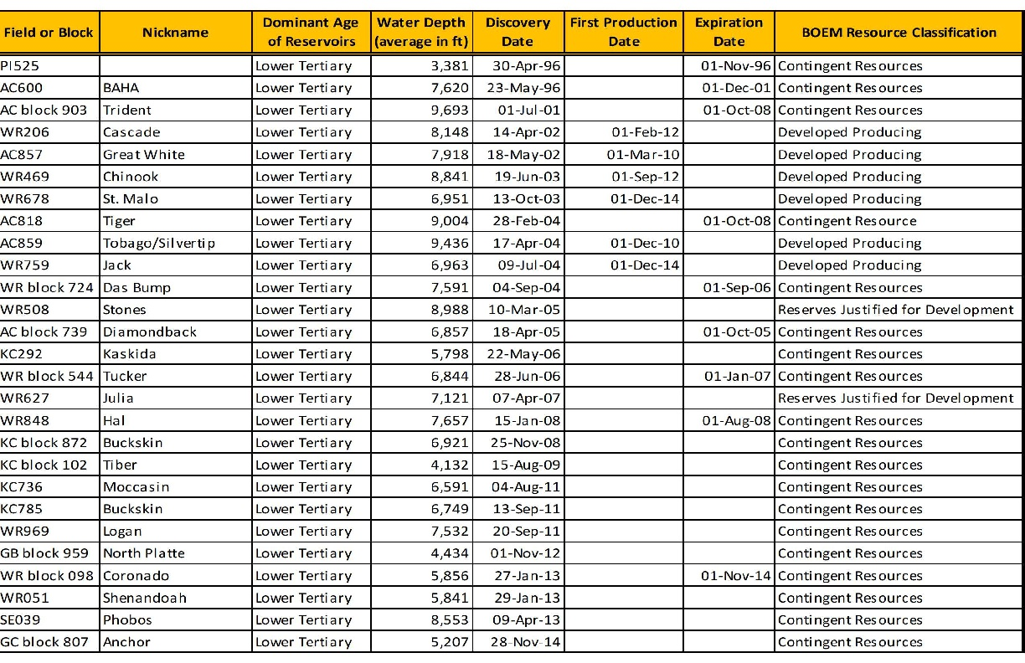
Dominant Fields and Resource Evaluation
Resource evaluation of lower tertiary wells showing contingent resource and developed resources.

Slide 17
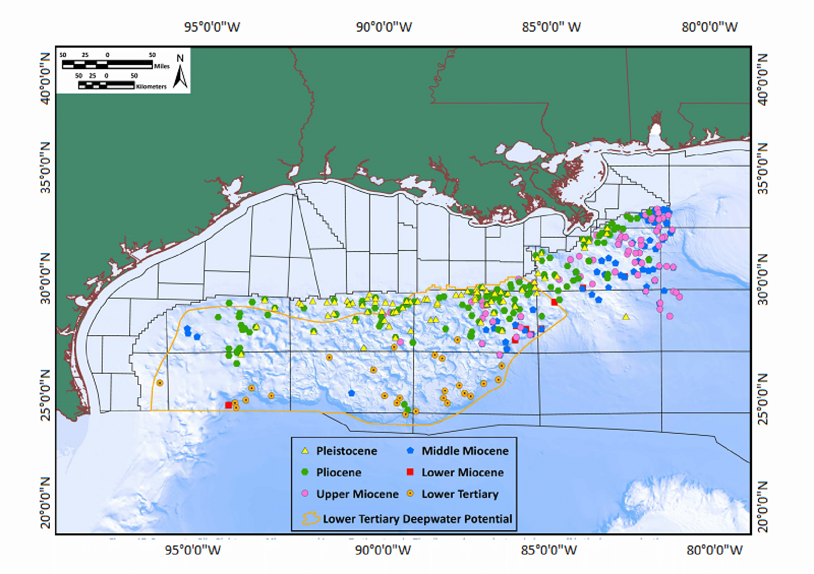
Boundary Identification
Identification of wells by latitude and longitude boundaries of Lower tertiary.

Slide 18
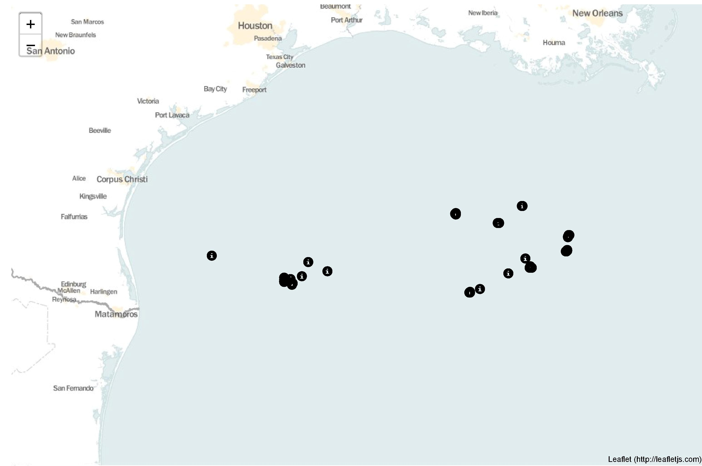
Lower Tertiary Wells by GIS Technologies
Map showing lower tertiary wells

Slide 19
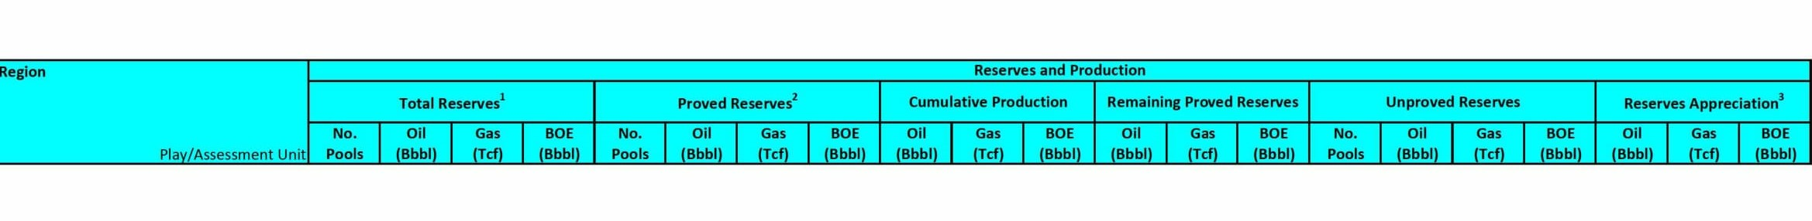
Reserves
Data gather from BOEM 2011 reserves and production Assessment
Total reserves will be updated soon

Slide 20
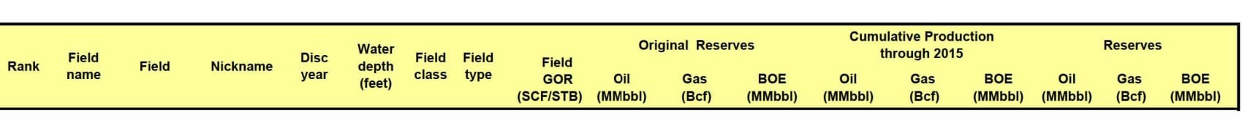
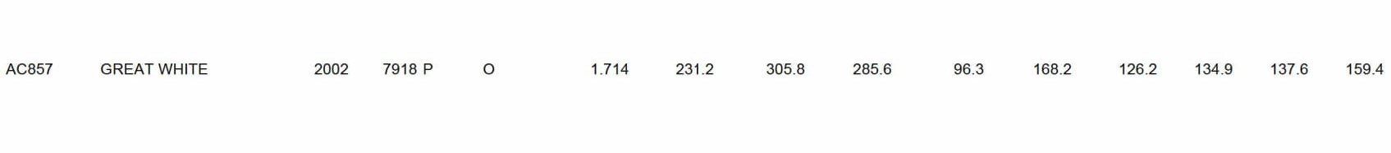
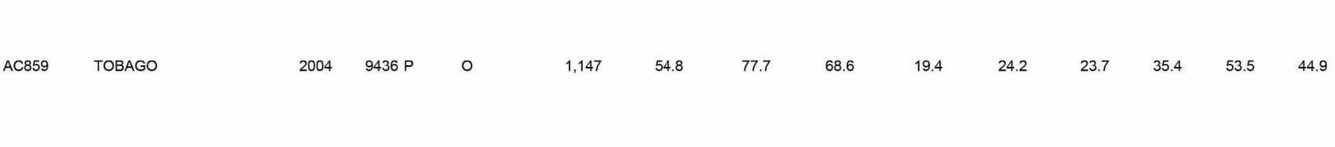
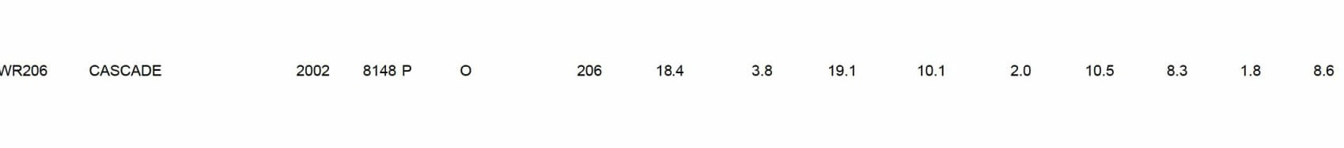
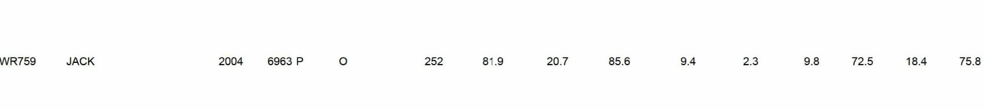
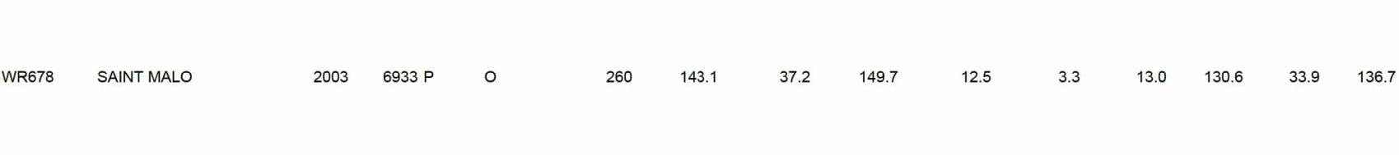
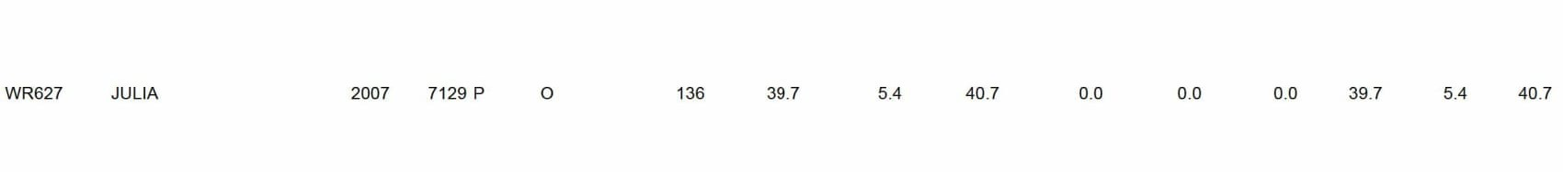
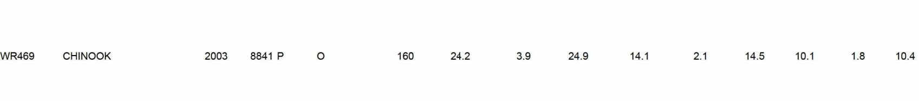
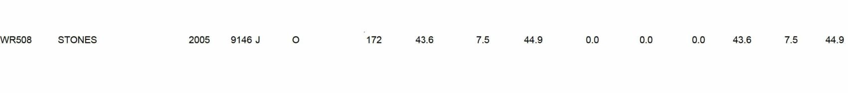
Reserves 2015
Reserves of developed producing and justified for development fields up to 2015

Slide 21
THANK YOU
For the opportunity to serve

